Slide 1
Movement Primitive
Diffusion
Learning Gentle Robotic Manipulation
of Deformable Objects
Blaine Swieder
Intelligent Surgical Robotics
Scheikl et al. • IEEE RA-L, 2024
Notes:
Scheikl et al. introduce MPD for gentle manipulation of deformable objects with limited demonstrations.
I’ll explain the method, evaluate its results, and connect it to our course and controls.
Sources and figure credits
https://arxiv.org/pdf/2312.10008v2 (title and abstract).
DOI: 10.1109/LRA.2024.3382529
https://scheiklp.github.io/movement-primitive-diffusion/

Slide 2
Motivation and Course Context
Task success alone leaves out how the robot moves.
Deformable tissue makes abrupt motion a concern.
Human demonstrations contain different valid strategies.
Surgical demonstrations are costly to collect.
Course connection: MPD turns learned behavior into structured robot motion.
Scheikl et al., RA-L 2024
2
Notes:
Completing a task does not tell us whether the robot moved tissue gently.
Demonstrations are costly and contain several valid strategies. The policy needs to preserve that variation.
MPD evaluates success, motion quality, and data efficiency together.
Sources and figure credits
https://arxiv.org/pdf/2312.10008v2 (Introduction).

Slide 3
Overview of Movement Primitive Diffusion
Diffusion represents several possible motion strategies.
ProDMPs structure the generated motion across time.
MPD combines both in one imitation-learning method.
The evaluation covers success, motion quality, and data efficiency.
Scheikl et al., RA-L 2024
3
Notes:
Diffusion models represent multiple possible action sequences.
MPD places a Probabilistic Dynamic Movement Primitive, or ProDMP, inside the denoiser to structure motion over time.
The authors test this combination on four tasks in simulation and physical bench setups, using state or image observations.
Sources and figure credits
https://arxiv.org/pdf/2312.10008v2 (Introduction, Sections III-D and IV).

Slide 4
Problem Formulation
o = recent observations τ = future action sequence
Each action contains desired values in a task-specific space.
Demonstrations pair observations with instrument motion.
Training uses shorter windows from complete demonstrations.
A sequence retains temporal context while allowing later adaptation.
Scheikl et al., RA-L 2024
4
Notes:
o means recent observations, supplied as task-state information or RGB images.
τ, pronounced ‘tau,’ is a future action sequence. Here it does not mean joint torque.
Actions specify task-space values such as instrument translation, rotation, or gripper articulation.
Training extracts short windows from complete demonstrations. The reported model uses three observations to predict twelve actions.
Sources and figure credits
https://arxiv.org/pdf/2312.10008v2 (Section III-A).

Slide 5
Why MPD Uses Diffusion
Several valid strategies can correspond to one observation.
A point-by-point average may create an unsuitable strategy.
Diffusion samples a possible sequence from a learned distribution.
MPD learns to denoise action sequences conditioned on observations.
Scheikl et al., RA-L 2024
5
Notes:
Multimodal behavior means several valid strategies for the same situation.
For illustration, averaging paths on opposite sides of an obstacle could create an unsuitable route. This is the mode-averaging concern.
Diffusion learns to denoise demonstrated sequences, then generates a possible strategy by repeatedly refining a random sample.
Sources and figure credits
https://arxiv.org/pdf/2312.10008v2 (Introduction and Section III-C). Obstacle example is an illustrative explanation of mode averaging.
https://scheiklp.github.io/movement-primitive-diffusion/ (multimodal behavior).

Slide 6
MPD’s Movement-Primitive Decoder
w shapes the trajectory through fixed basis functions.
The boundary terms set the starting position and velocity.
The model supports position and velocity along the same motion.
Here, t is time along the generated movement.
Scheikl et al., RA-L 2024
6
Notes:
These equations describe one controlled degree of freedom. y is position, and y-dot is velocity.
c₁ and c₂ set the boundary conditions. y₁ and y₂ are homogeneous solutions, Φ contains basis functions, and w shapes the motion.
Dots indicate derivatives with respect to movement time. T means transpose.
The same weights determine position and velocity. w describes the current motion, while θ denotes trained network parameters.
Sources and figure credits
https://arxiv.org/pdf/2312.10008v2 (Equation 1, Section III-B).

Slide 7
Initial Conditions and Continuity
A new segment can start from a specified position and velocity.
Matching both helps connect consecutive reference motions.
The reference construction supplies temporal consistency.
Feedback control still determines how the physical robot follows it.
Scheikl et al., RA-L 2024
7
Notes:
The decoder can start a motion segment at a specified position and velocity.
Matching both helps connect consecutive reference segments without an abrupt velocity change.
This guarantee concerns the reference. Physical tracking still depends on feedback, calibration, disturbances, and actuator limits.
Sources and figure credits
https://arxiv.org/pdf/2312.10008v2 (Sections III-B and III-D). Physical tracking discussion is presenter interpretation.

Slide 8
MPD’s Probability-Flow ODE
D_{θ} estimates a denoised sequence under the observation o.
The solver iteratively updates the noisy action sequence.
Diffusion time differs from time along the robot trajectory.
This ODE describes generation, rather than tissue dynamics.
Here, t is diffusion time, tied to the noise level.
Scheikl et al., RA-L 2024
8
Notes:
Dθ, read ‘D-theta,’ estimates a denoised action sequence conditioned on observations o.
The ODE updates the candidate sequence using its difference from the denoiser output, divided by t. Here σ(t) = t.
t is diffusion time/noise level, distinct from robot execution time. The paper uses Euler’s method.
MPD trains with denoising score matching. This ODE generates motion rather than identifying tissue dynamics.
Sources and figure credits
https://arxiv.org/pdf/2312.10008v2 (Equations 2–5 and Section IV-C).

Slide 9
Connection to Neural ODEs
Aspect | Neural ODE (my demo) | Movement Primitive Diffusion
Learned function | State derivative f_{θ}(x, u, t) | Denoiser D_{θ} with a ProDMP
Integrated quantity | System state x | Noisy action sequence τ
Integration coordinate | Physical system time | Diffusion time / noise level
Purpose | Predict the system response | Generate a future motion reference
The common idea is learning with continuous functions and an ODE solver.
MPD applies that idea to generating a motion sample.
Scheikl et al., RA-L 2024
9
Notes:
The connection to my Neural ODE presentation is a learned function evaluated within numerical integration.
My Silverbox demo integrated a state derivative over system time. MPD refines noisy actions over diffusion time to generate a motion reference.
Neural ODEs can also describe latent features or network depth. This is a computational connection, not evidence that MPD learns tissue dynamics.
Sources and figure credits
https://arxiv.org/pdf/2312.10008v2 (Equations 2–7, Sections III-C and III-D).
https://papers.neurips.cc/paper_files/paper/2018/hash/69386f6bb1dfed68692a24c8686939b9-Abstract.html (Chen et al., Neural Ordinary Differential Equations, NeurIPS 2018).
Blaine Swieder, Neural ODEs: Dynamic Surrogate Modeling, CS 8395-04, slides 2–5 and the Silverbox demonstration.

Slide 10
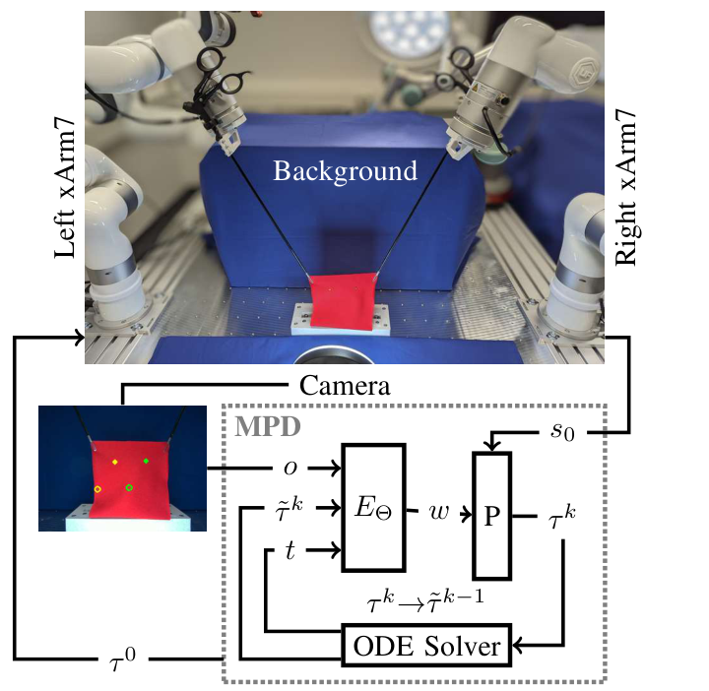
The MPD Architecture
Condition the network on the observation and noisy sequence.
Predict a movement-primitive weight vector.
Decode weights with the initial position and velocity.
Use the ODE solver to continue denoising.
Scheikl et al., RA-L 2024
10
Notes:
The network EΘ receives observations, a noisy sequence, and the noise level, then predicts primitive weights w.
The ProDMP decoder P combines w with the starting position and velocity s₀ to produce a trajectory.
The ODE solver repeatedly updates the candidate sequence. Final weights generate the execution reference.
The primitive operates inside denoising, rather than smoothing the finished output afterward.
Sources and figure credits
https://arxiv.org/pdf/2312.10008v2 (Figure 1 and Section III-D). Figure reproduced intact with its original labels.

Slide 11
Notation in the MPD Architecture
Symbol | Meaning in this paper
o | Recent observations: task state or RGB images
 | Action sequence, noisy candidate, and final denoised sequence
t, k | Diffusion time / noise level, and denoising iteration
E_{Θ} | Inner neural network that predicts primitive coefficients
w | Movement-primitive coefficients for the current motion
P | ProDMP decoder that turns coefficients into a trajectory
s₀ | Starting position and velocity for the motion segment
D_{θ} | Overall learned denoiser used by the probability-flow ODE
Scheikl et al., RA-L 2024
11
Notes:
o means observations. τ means action sequence. A tilde marks a noisy candidate, k counts denoising updates, and τ⁰ is the final sequence.
t specifies diffusion time/noise level. EΘ predicts w, and P decodes w with initial position and velocity s₀.
Dθ is the overall denoiser. Network parameters θ or Θ stay fixed during inference; generated motion coefficients w vary.
Sources and figure credits
https://arxiv.org/pdf/2312.10008v2 (Figure 1, Section III-A and Equations 4–5 in Section III-C, Section III-D).

Slide 12
Diffusion in Action-Sequence Space
The inner network predicts weights for a ProDMP.
The decoder returns trajectory values during each update.
MPD diffuses in action-sequence space.
The authors report worse preliminary results for weight-space diffusion.
Scheikl et al., RA-L 2024
12
Notes:
The network predicts ProDMP weights, but diffusion still operates in action-sequence space.
The decoder maps weights back to trajectory values at each update, retaining temporal structure for the transformer.
The authors report lower preliminary success for direct weight-space diffusion, without a full numerical ablation table.
Sources and figure credits
https://arxiv.org/pdf/2312.10008v2 (Section III-D, discussion of weight-space diffusion).

Slide 13
Training MPD
Extract observation and action windows from demonstrations.
Sample a noise level and corrupt the demonstrated action sequence.
Predict primitive weights and decode a reconstructed sequence.
Optimize the denoising objective against the demonstration.
Scheikl et al., RA-L 2024
13
Notes:
Training pairs observation windows with demonstrated action sequences and corrupts the actions with Gaussian noise.
The model predicts primitive weights, decodes a sequence, and compares that reconstruction with the demonstration using the denoising objective.
Weights are an internal representation. The learning target remains demonstrated motion in sequence space. All methods use AdamW.
Sources and figure credits
https://arxiv.org/pdf/2312.10008v2 (Equations 6–7, Sections III-C, III-D and IV-C).

Slide 14
Execution and Sampling Rates
Quantity | Reported setting
Observation history | 3 samples
Predicted action sequence | 12 steps
Observation / action spacing | 0.1 s (10 Hz)
Physical reference spacing | 0.005 s (200 Hz)
ProDMP basis functions | 3
Reference sampling and policy inference describe different rates.
Scheikl et al., RA-L 2024
14
Notes:
Three observations condition twelve predicted actions, spaced 0.1 seconds apart.
Physical references use 0.005-second spacing, or 200 Hz. MPD evaluates its continuous decoder; baselines use linear interpolation.
The setup uses three ProDMP basis functions and Euler’s method.
The separately reported inference capacity of about 90 Hz is distinct from reference sampling and actual replanning frequency.
Sources and figure credits
https://arxiv.org/pdf/2312.10008v2 (Sections III-D, IV-C and VI).

Slide 15
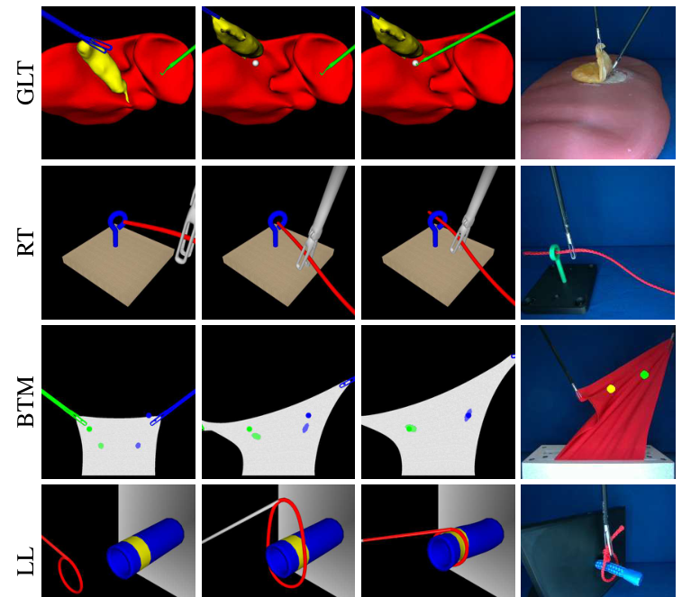
Tasks Used in the Evaluation
Grasp Lift Touch: sequential bimanual coordination.
Rope Threading: navigation through an eyelet.
Bimanual Tissue Manipulation: coordinated deformation.
Ligating Loop: positioning a flexible loop.
Scheikl et al., RA-L 2024
15
Notes:
Grasp Lift Touch requires sequential coordination: one instrument retracts the gallbladder while another touches a target.
Rope Threading tests a path through an eyelet.
Bimanual Tissue Manipulation tests coordinated tissue deformation.
Ligating Loop tests positioning a flexible loop around a tube. The final figure column shows each physical setup.
Sources and figure credits
https://arxiv.org/pdf/2312.10008v2 (Figure 2 and Section IV-A). Figure retained in full.

Slide 16
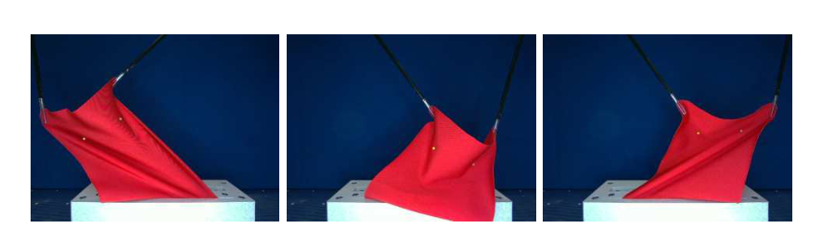
Physical Experiments
xArm7 manipulators use laparoscopic instruments and RGB images.
Cloth and phantoms represent the deformable objects.
The physical Ligating Loop task omits constriction.
Scheikl et al., RA-L 2024
16
Notes:
The bench setup uses xArm7 manipulators, laparoscopic instruments, and an Intel RealSense D405 camera.
Cloth and phantoms replace living tissue. The cloth’s folds and slack illustrate differences from simulation.
Physical Ligating Loop omits constriction. These experiments do not establish performance in animal or human surgery.
Sources and figure credits
https://arxiv.org/pdf/2312.10008v2 (Figure 3 and Section IV-A). Figure contains all original cloth examples.

Slide 17
Data and Evaluation Protocol
Task | Simulation demos | Physical demos
Grasp Lift Touch | 90 | 45
Rope Threading | 200 | 45
Bimanual Tissue Manipulation | 150 | 200
Ligating Loop | 135 | 45
One demonstrator. Five simulation seeds. Fifty physical test runs per model.
Scheikl et al., RA-L 2024
17
Notes:
One proficient demonstrator records trajectories with an Xbox controller at 10 Hz. The table lists default dataset sizes.
Simulation uses five seeds and up to 3,000 epochs, with 100 evaluation rollouts every 100 epochs.
Physical evaluation uses 50 executions per model. Data-efficiency tests vary the training subset separately.
Motion metrics use each run’s highest-success checkpoint, so they compare best achieved performance.
Sources and figure credits
https://arxiv.org/pdf/2312.10008v2 (Section IV-C). Default dataset counts and evaluation protocol.

Slide 18
Baselines Used to Evaluate MPD
Method | Diffusion | Network | Motion representation
BESO | Score-based | Transformer | Sequence denoising
DP-T | DDPM | Transformer | Sequence denoising
DP-C | DDPM | Temporal CNN | Sequence denoising
MPD | Score-based | Transformer | ProDMP inside the denoiser
The comparisons change more than one architectural choice.
Scheikl et al., RA-L 2024
18
Notes:
DP-T uses a transformer and DP-C a temporal CNN. Both use DDPM diffusion.
BESO and MPD use score-based diffusion with transformers. MPD adds the ProDMP decoder.
Some comparisons change both architecture and diffusion framework, so they do not isolate only the primitive’s effect. Hardware tests compare MPD with DP-C.
Sources and figure credits
https://arxiv.org/pdf/2312.10008v2 (Sections III-C, III-D and IV-C).

Slide 19
Motion-Quality Metrics
Metric | Meaning in this study
Tissue / marker acceleration | How strongly the manipulated object accelerates
Instrument jerk | How abruptly instrument acceleration changes
Instrument “energy” | An acceleration-sum motion proxy
Path length | Total distance travelled by the instrument
Episode length | Time required to finish the task
These motion metrics complement the task-success rate.
Scheikl et al., RA-L 2024
19
Notes:
Tissue acceleration measures object motion. Instrument jerk measures how abruptly acceleration changes.
Instrument ‘energy’ is an acceleration-sum proxy, not energy measured in joules.
Path length measures travel; episode length measures completion time.
Physical BTM uses marker acceleration as a tissue-motion surrogate. These metrics complement success and do not directly measure injury.
Sources and figure credits
https://arxiv.org/pdf/2312.10008v2 (Section IV-B and Figure 7 caption).

Slide 20
Results with State Observations
Method | GLT | RT | BTM | LL | Average
BESO | 68.4 (6.8) | 90.4 (1.2) | 88.2 (3.9) | 83.2 (4.8) | 82.55
DP-T | 100 (0.0) | 89.6 (1.9) | 98.4 (0.5) | 100 (0.0) | 97.00
DP-C | 100 (0.0) | 82.0 (2.3) | 93.2 (1.9) | 100 (0.0) | 93.80
MPD | 99.2 (0.7) | 93.8 (1.2) | 99.0 (0.6) | 99.6 (0.5) | 97.90
Success (%), mean (SD). MPD leads the average by 0.90 percentage points over DP-T.
Scheikl et al., RA-L 2024
20
Notes:
Entries are mean success percentages with standard deviations across five models.
MPD leads the four-task average at 97.90%, versus 97.00% for DP-T: a 0.90-percentage-point difference.
MPD leads RT and BTM here; DP-T reaches 100% on GLT and LL. The table provides no significance test for the average difference.
Sources and figure credits
https://arxiv.org/pdf/2312.10008v2 (Table I, State Observations). Native table preserves every reported mean and standard deviation.

Slide 21
Results with Image Observations
Method | GLT | RT | BTM | LL | Average
BESO | 99.8 (0.4) | 66.8 (2.3) | 91.4 (2.4) | 99.8 (0.4) | 89.45
DP-T | 100 (0.0) | 76.6 (4.5) | 95.8 (0.7) | 99.8 (0.4) | 93.05
DP-C | 100 (0.0) | 83.2 (1.2) | 85.2 (1.3) | 100 (0.0) | 92.15
MPD | 100 (0.0) | 78.6 (3.4) | 99.0 (1.1) | 100 (0.0) | 94.40
MPD leads the average, while DP-C performs best on image-based Rope Threading.
Scheikl et al., RA-L 2024
21
Notes:
With images, MPD has the highest average at 94.40%, versus 93.05% for DP-T.
BTM is strong for MPD at 99.0%. On Rope Threading, DP-C leads at 83.2%, versus 78.6% for MPD.
The results favor MPD overall while showing task-dependent differences. It does not win every comparison.
Sources and figure credits
https://arxiv.org/pdf/2312.10008v2 (Table I, Image Observations). Native table preserves every reported mean and standard deviation.

Slide 22
Results on the Physical Robots
Task / condition | MPD | DP-C
BTM (2 mm threshold, state input) | 90% | 70%
Grasp Lift Touch | 100% | 100%
Rope Threading | 96% | 100%
Ligating Loop (simplified) | 100% | 100%
Fifty executions per evaluated model. Hardware comparison: MPD and DP-C.
Scheikl et al., RA-L 2024
22
Notes:
Only MPD and DP-C run on hardware. The authors say the other methods would require substantial motion postprocessing.
For state-input BTM at a 2 mm threshold, MPD succeeds in 90% of 50 trials, versus 70% for DP-C.
Both reach 100% on GLT and simplified LL. Rope Threading is 96% for MPD and 100% for DP-C.
MPD’s two rope failures produce unfamiliar bent configurations from which it cannot recover.
Sources and figure credits
https://arxiv.org/pdf/2312.10008v2 (Section V, Figure 5 and Section IV-A). Native table recreated from reported physical results.

Slide 23
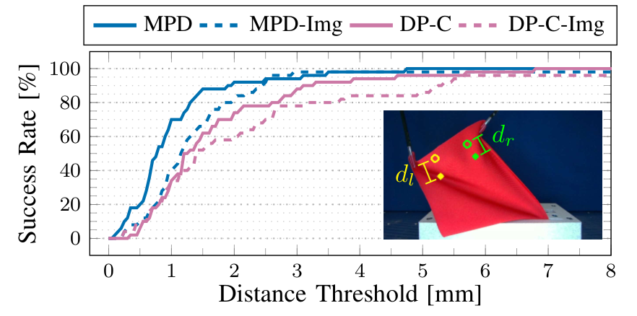
Accuracy Threshold and Task Success
Both marker errors must satisfy the chosen distance threshold.
The reported success rate depends on the required accuracy.
Scheikl et al., RA-L 2024
23
Notes:
Success requires both marker-to-target errors to fall below the chosen threshold. Solid curves use state inputs; dashed curves use images.
State-input MPD reaches 90% at 2 mm. Both methods reach 100% beyond about 6.5 mm.
Success percentages depend on the tolerance. A surgical application would need its own justified accuracy requirement.
Sources and figure credits
https://arxiv.org/pdf/2312.10008v2 (Figure 5 and Section V). Complete figure, including legend, axes and marker illustration.

Slide 24
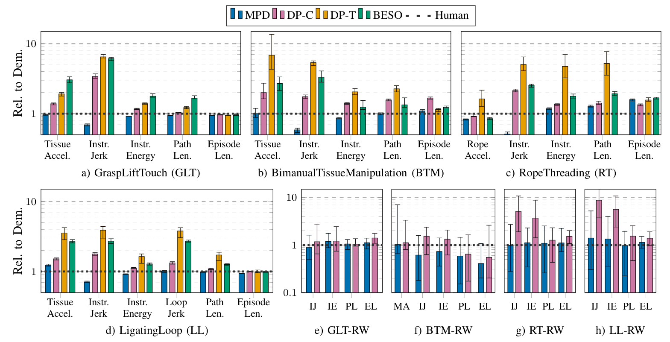
Motion Quality in the Experiments
Human reference = 1. Lower is better. Error bars show minima and maxima.
Scheikl et al., RA-L 2024
24
Notes:
MPD is blue. The dotted human-demonstration reference is 1, and the vertical axes are logarithmic.
Bars show means with minimum/maximum error bars, not standard deviations.
MPD generally has favorable motion metrics, particularly instrument jerk. Physical BTM uses marker acceleration; other physical panels omit direct tissue acceleration.
Lower metrics support gentler motion but do not establish tissue-injury reduction or a contact-force limit.
Sources and figure credits
https://arxiv.org/pdf/2312.10008v2 (Figure 7, Sections IV-B and V). All panels and the original legend retained.

Slide 25
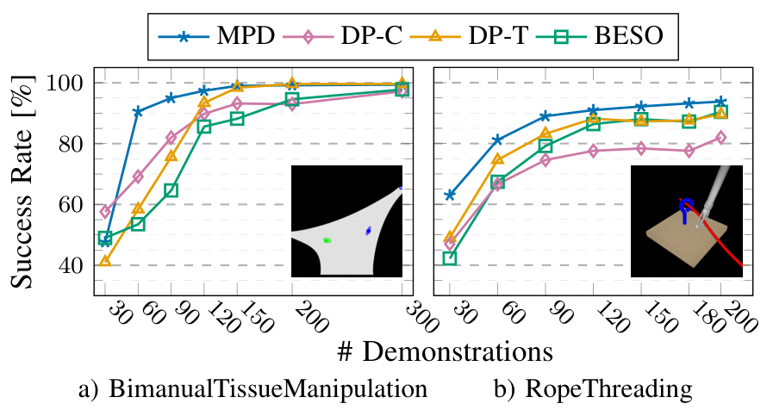
Demonstration Data Efficiency
BTM example: about 90% success with 90 demos for MPD and 120 for DP-T.
Scheikl et al., RA-L 2024
25
Notes:
Figure 6 varies demonstration count for state-input BTM and Rope Threading.
The authors report about 90% BTM success with 90 demonstrations for MPD, versus about 120 for DP-T.
The benefit is task-dependent. More data does not guarantee monotonic improvement, and coverage of relevant states still matters.
Sources and figure credits
https://arxiv.org/pdf/2312.10008v2 (Figure 6, Sections V and VI). Complete two-panel figure with the original legend and axes.

Slide 26
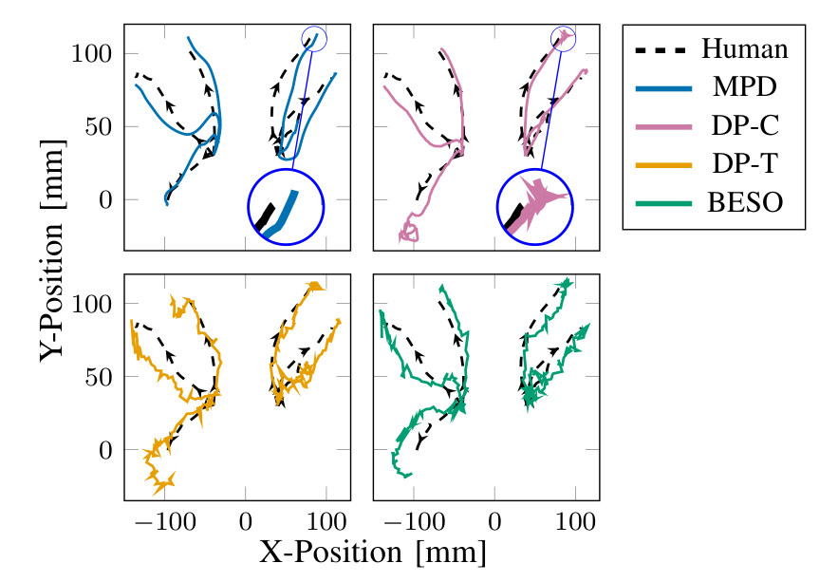
Generated Instrument Trajectories
Path shape makes the motion-quality difference visible.
Scheikl et al., RA-L 2024
26
Notes:
Black dashed paths show human demonstrations. Each panel compares one method on simulated BTM.
MPD’s smoother paths illustrate the practical difference between task completion and motion quality.
This is qualitative evidence. Read it with jerk and acceleration metrics; a 2D projection alone cannot establish 3D motion quality or contact forces.
Sources and figure credits
https://arxiv.org/pdf/2312.10008v2 (Figure 4 and Section V). Complete Cartesian trajectory figure, including all four methods and the legend.

Slide 27
Advantages of MPD
Represents different valid demonstrated behaviors.
Sets the initial position and velocity of each motion segment.
Produces high-frequency references from a continuous decoder.
Improves motion metrics on the evaluated tasks.
Learns useful behavior with fewer demonstrations in the reported tests.
Scheikl et al., RA-L 2024
27
Notes:
MPD combines multiple possible behaviors with a structured, continuous trajectory representation.
Specified starting position and velocity help connect segments, and the decoder directly produces high-frequency references.
The evaluated tasks show favorable motion metrics and data efficiency with state or image observations. The value is this combination of outcomes.
Sources and figure credits
https://arxiv.org/pdf/2312.10008v2 (Sections III-D, V and VI).

Slide 28
Limitations and Open Problems
Unfamiliar failure states can prevent recovery.
Smooth references do not supply a contact-force guarantee.
Sampling and representation choices add design and computation costs.
The hardware tests compare only MPD and DP-C.
Bench substitutes leave clinical generalization unresolved.
Scheikl et al., RA-L 2024
28
Notes:
The bent-rope failures show poor recovery outside the demonstration distribution.
Smooth references do not guarantee safe contact forces. Sampling and representation choices also introduce design and computation costs.
Clinical transfer remains unresolved: bench substitutes, one demonstrator, and a hardware comparison limited to MPD and DP-C.
Possible representation-flexibility and force-safety tradeoffs are discussion points, not additional results demonstrated here.
Sources and figure credits
https://arxiv.org/pdf/2312.10008v2 (Sections IV and VI). Force-safety and representation-flexibility points are presenter interpretation.

Slide 29
Discussion: The Controls Perspective
MPD supplies a learned reference for the physical system.
Tracking control still handles execution and disturbances.
Interaction sensing could help detect a bad plan or contact state.
Supervisory logic could manage replanning and human intervention.
Scheikl et al., RA-L 2024
29
Notes:
From my controls perspective, MPD supplies a reference. Tracking control still handles the plant and disturbances.
Interaction sensing and supervisory logic could detect a bad contact state, trigger replanning, or request human intervention.
Those are possible extensions, not demonstrated MPD components. This separation of generation, tracking, and monitoring also fits CPS and FSW research.
Sources and figure credits
https://arxiv.org/pdf/2312.10008v2 (Sections III and VI). Control architecture, force-estimation, CPS and FSW connections are presenter synthesis.

Slide 30
Five Main Takeaways
Task success and motion quality answer different questions.
Diffusion captures variation. ProDMPs structure the trajectory.
Initial conditions help connect consecutive motion segments.
MPD needs fewer demonstrations in the reported comparisons.
Recovery and clinical safety still require further work.
Scheikl et al., RA-L 2024
30
Notes:
Evaluate task success and motion quality separately.
Diffusion preserves behavioral variation; ProDMPs structure motion.
Initial position and velocity help connect segments, while physical tracking remains a control problem.
The reported comparisons show improved data efficiency.
Recovery and clinical safety remain open.
Sources and figure credits
https://arxiv.org/pdf/2312.10008v2 (synthesis of Sections III–VI).

Slide 31
MPD’s Position in Our Course
Perception papers estimate tissue shape and motion.
Gesture and skill papers represent the surgeon’s behavior.
SUFIA-BC learns actions from demonstrations.
MPD structures the motion produced by a learned policy.
STAR connects task planning with supervised physical execution.
Scheikl et al., RA-L 2024
31
Notes:
Our readings progress from perceiving tissue and recognizing behavior to learning actions from demonstrations.
MPD adds temporal structure to learned motion. STAR provides a separate example of planning, feedback, and supervised execution.
This is a conceptual reading map, not one implemented pipeline. SE(3) supplies pose geometry; MPD addresses motion over time.
Sources and figure credits
Jie Ying Wu, Week 7 lecture slides, slides 10–11, 20 and 49–51.
https://arxiv.org/pdf/2312.10008v2 (Sections III-A and VI). SUFIA-BC, STAR and SE(3) connections reflect the course readings discussed here.

Slide 32
Questions for Discussion
What would we measure before calling the manipulation safe?
Would corrective demonstrations improve the rope-recovery failure?
How should feedback change the motion when tissue moves unexpectedly?
Scheikl et al., RA-L 2024
32
Notes:
What would establish safety? I’d measure contact forces, tissue strain/damage, tracking error, collisions, and recovery reliability against validated, tissue-specific limits. MPD’s jerk and acceleration metrics provide useful evidence, but don’t establish tissue safety by themselves. deformable-workshop.github.io
Could corrective demonstrations help? Yes, potentially. Demonstrate recovery starting from bent-rope states, retrain, and test on unseen failures. This follows the idea of teaching corrections in states the policy actually encounters; it remains a proposed extension for MPD. proceedings.mlr.press
What should trigger intervention? I’d trigger replanning when observed tissue motion deviates substantially from predictions or a grasp slips. Force/strain feedback could provide additional triggers. Exceeding validated safety limits, losing reliable tracking, or repeatedly failing to recover should trigger a safe pause and human intervention.
Sources and figure credits
Presenter questions informed by https://arxiv.org/pdf/2312.10008v2 (Sections V and VI).

Slide 33
Main Paper and Supporting Resources
Movement Primitive Diffusion
Scheikl, P. M., et al. “Movement Primitive Diffusion: Learning Gentle Robotic Manipulation of Deformable Objects.” IEEE Robotics and Automation Letters 9(6), 5338–5345, 2024.
https://doi.org/10.1109/LRA.2024.3382529
Project Page, Code, Data, and Demonstration Video
https://scheiklp.github.io/movement-primitive-diffusion/
Scheikl et al., RA-L 2024
33
Notes:
The main source is Scheikl et al.’s MPD paper. Its project page links the code, data, and demonstration video.
Diffusion Policy and ProDMP supply method background. Chen et al. (2018) supports the brief Neural ODE comparison; course links are presenter synthesis.
Sources and figure credits
https://arxiv.org/pdf/2312.10008v2
https://doi.org/10.1109/LRA.2024.3382529
https://scheiklp.github.io/movement-primitive-diffusion/
Method background cited by MPD: Chi et al., Diffusion Policy, RSS 2023. Li et al., ProDMP, IEEE RA-L 8(4), 2325–2332, 2023.
Neural ODE comparison: https://papers.neurips.cc/paper_files/paper/2018/hash/69386f6bb1dfed68692a24c8686939b9-Abstract.html

